Slide 1
CS 447/647
Where to Start

Slide 2
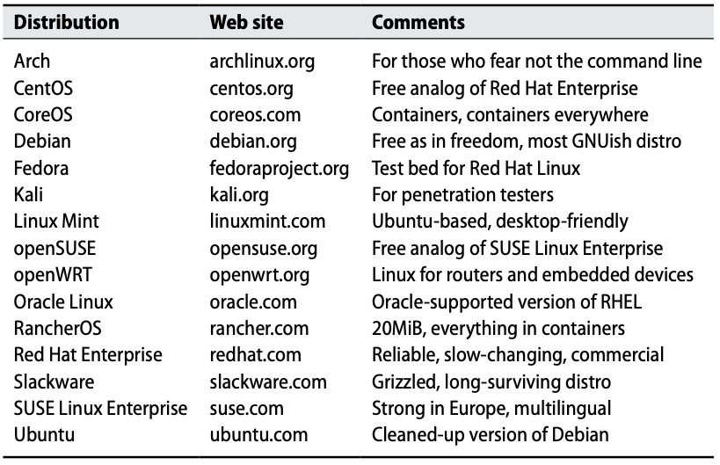
Most popular general-purpose Linux distributions
Notes:
Arch requires manual installation of:
Disk partitioning
Filesystem mounting
Bootloader
Network interfaces
Base system
Locales
Kernel and drivers
DE/WM
systemD services
CoreOS EoL in 2020 in favor of Fedora CoreOS and RHEL CoreOS
Red Hat uses Fedora as testing grounds for software and features that will eventually be added to RHEL
Alpine Linux - Extremely minimal, base image for many docker containers, common for embedded systems and HPC

Slide 3
BSD
Unix-like
Berkeley Software Distribution
FreeBSD - 1993
Most commonly used BSD OS today
TrueNAS, OPNsense, pfSense
NetBSD - 1993
Focus on portability/compatibility
Use is largely restricted to embedded systems and retrocomputing
OpenBSD
Focus on security
Origin of OpenSSH (OpenBSD Secure Shell)
macOS

Slide 4
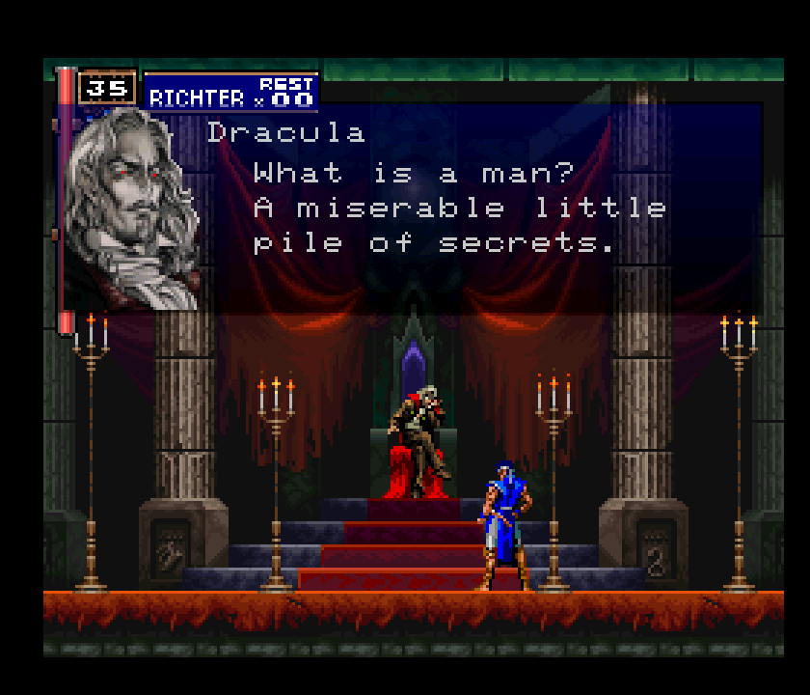
manpage?
Notes:
According to Dracula
That’s right not only are we going to read the manual. We are going to add to it.

Slide 5
bash
Keep scripts small
Automate as much as possible
Learning a few tools well
vi
vim/nano
emacs
awk
csvtool
tmux - terminal multiplexer
Don’t optimize prematurely
Exit codes - $?
0 - Everything went fine
non-zero - Something broke

Slide 6
bash configuration and dotfiles
/etc/bash.bashrc - System-wide .bashrc file for interactive bash(1) shells.
/etc/profile - Profile file for sh(1) and bash(1)
/etc/profile.d - Collections of profile scripts.
Often used for $PATH modifications
modules!
~/.bashrc - Interactive shell configuration file
~/.bash_profile - Executed for login shells

Slide 7
“Classic Unix documentation is written to be telegraphic but complete… The style assumes an active reader, one who is able to deduce obvious unsaid consequences of what is said, and who has the self-confidence to trust those deductions. Read every word carefully, because you will seldom be told anything twice.”
Eric Raymond

Slide 8
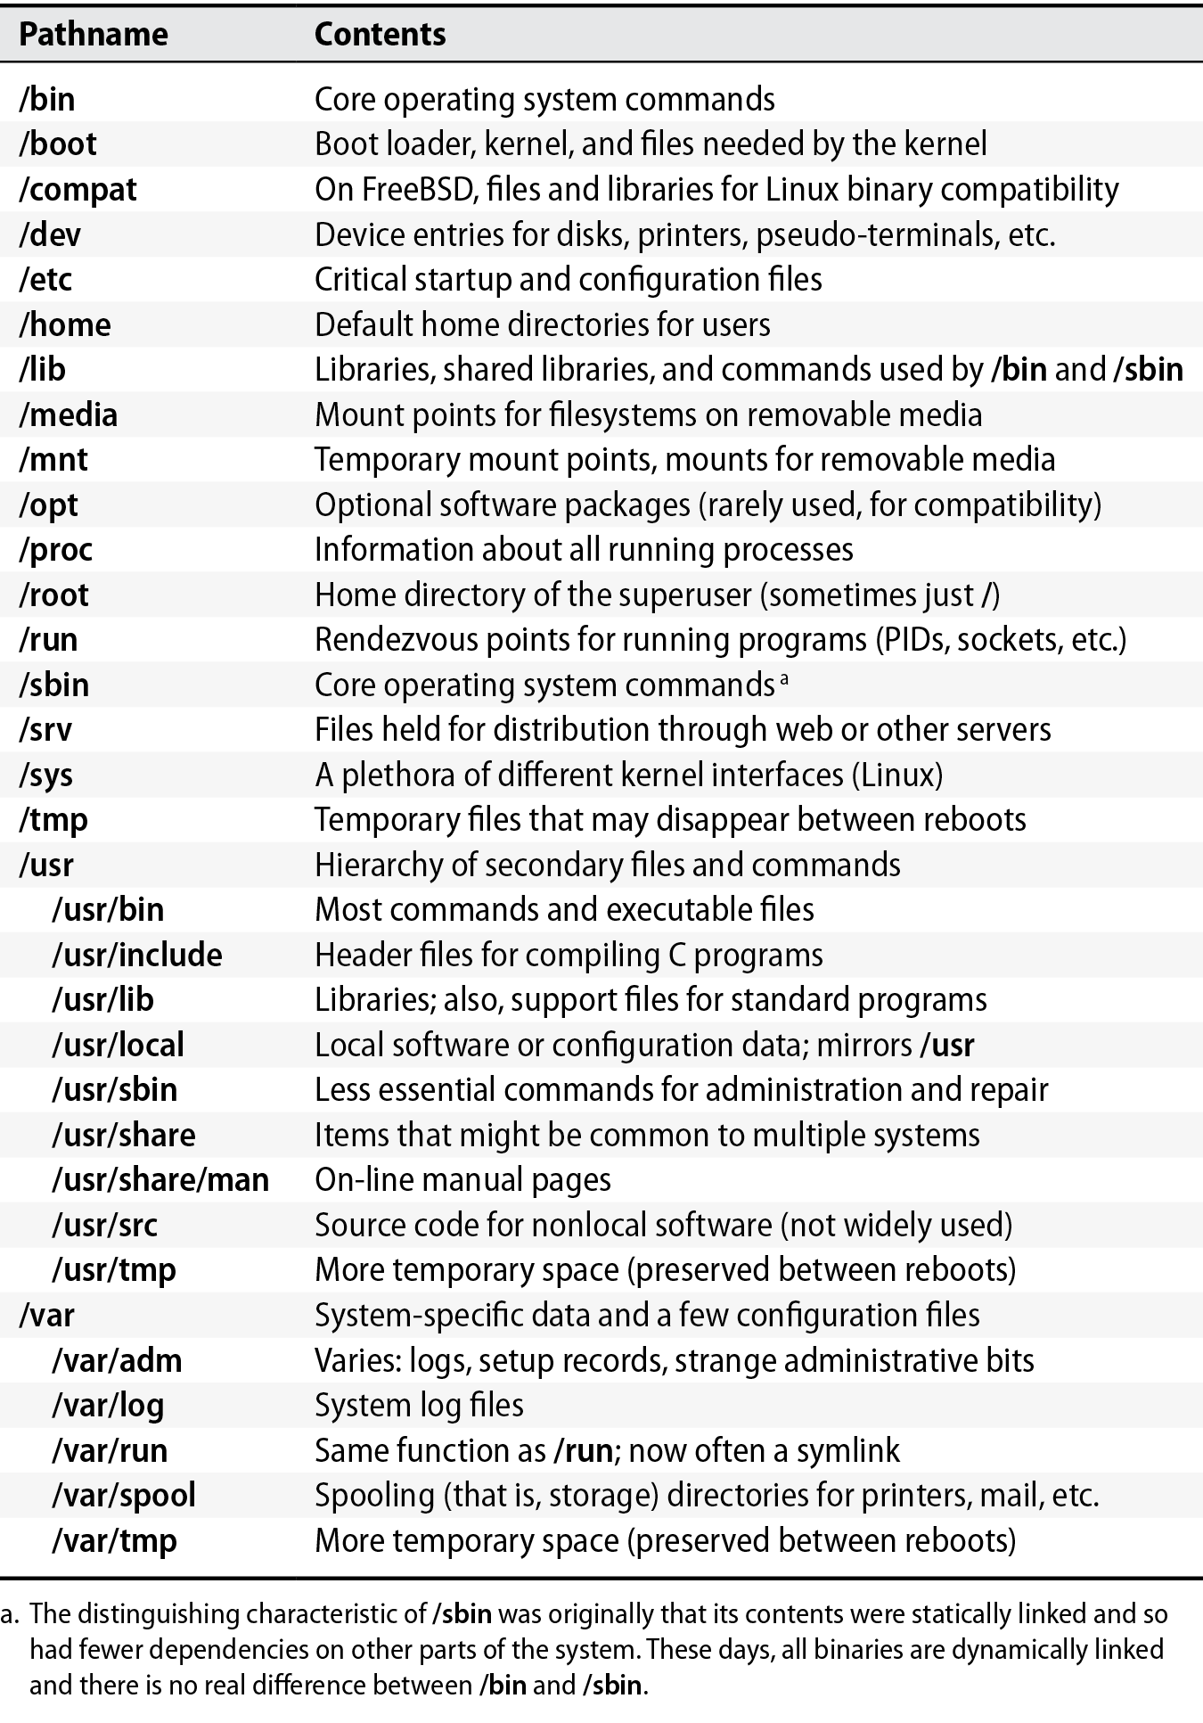
Notes:
* They must be used on a graphics display to work on a document.
* Most of the WYSIWYG systems are either non-free or are not very
portable.
* 'troff' is firmly entrenched in all Unix systems.
* It is difficult to have a wide range of capabilities within the
confines of a GUI/window system.
* It is more difficult to make global changes to a document.
df -h /dev/shm

Slide 9
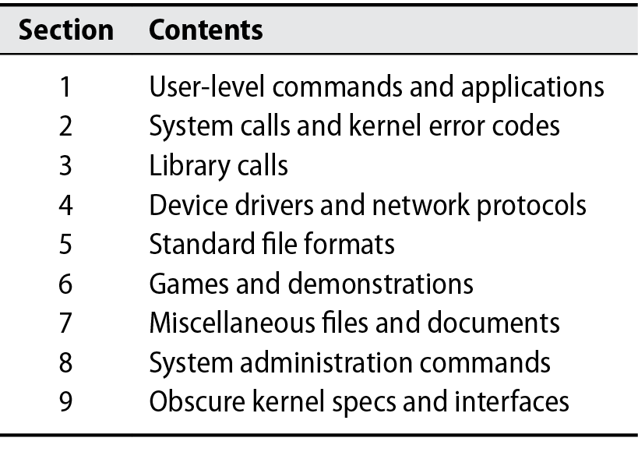
Back to man

Slide 10
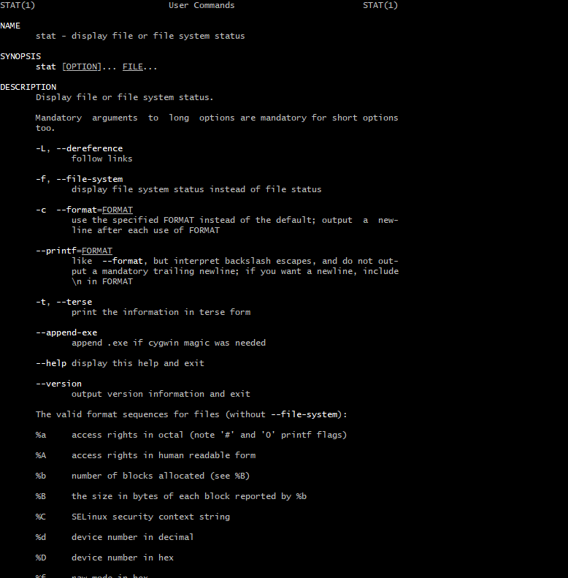
man

Slide 11
How are man pages rendered?
groff
System for typesetting documents
Similar to TeX..
troff in 1971.
groff in 1990
More like a compiler
Text input files with embedded formatting
man 7 groff_man
Notes:
“run off a document”
The g is stands for grandpa, jk it’s gnu roff
Who says we don’t teach you anything contemporary. Calculus is 400 years old…
Tour of an older Unix system
Insight into modularity and design philosophy

Slide 12
man
apt install -y man manpages manpages-dev info groff
mandb #Regenerate manpages from roff source. #Config in /etc/manpath.config
man -k ext4 # Keyword search for string “ext4”
man -K ext4 # Page through manpages that contain ext4
man -a intro # Page through the intro manual
man ls # manpage for ls
# Why do we need any of this when Google exists?
Notes:
Offline use in air gapped systems
Differences in versions

Slide 13
Tmux demo

